Slide 1


Towards Improved Safety Labeling
Testimonial from an A.I.S.E. company
Paul Clohessy (P&G) for A.I.S.E.

Slide 2
AISE embraces the opportunity of this workshop and the planned consumer research program to help consumers notice, understand, and act upon safety information
AISE has a long history of dialogue with stakeholders at EU and national level in progressing the safety and sustainability agenda of our sector (Sustainable Cleaning Charter 2004)

Slide 3
Do consumers notice, understand & act on safety labeling ?

Slide 4
Do consumers notice, understand & act on safety labeling ?
Safety information labeled on detergents
  CLP Regulation mandated hazard symbols, hazard & precautionary phrases, ingredients contributing to classification
  Detergent Regulation mandated ingredient list
  Product usage instructions
  AISE safety symbols (voluntary & supplemental to required elements)

Slide 5
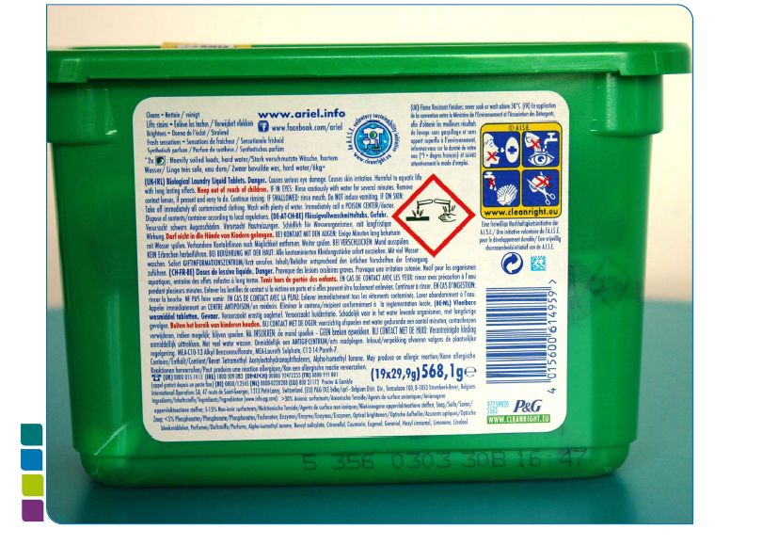
Safety information tends to be labeled Back of Pack
AISE
Safe Use
Icons
CLP
Regulation
(Branding)
Detergent
Regulation

Slide 6
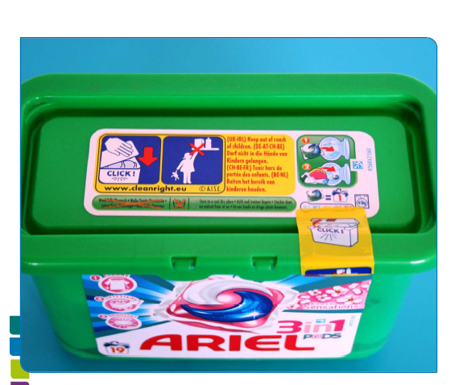
Safety information sometimes repeated on top of pack & on inner packaging
AISE
Safe Use
Icons
Usage Instructions
CLP Regulation

Slide 7
Do consumers notice, understand & act on safety labeling ?
  Congested labels since July 2015
    CLP classified more products
      increased space demands raising inventory complexity with more labels (skus) required to accommodate European language needs
      higher costs with labeling multiple packaging layers
        new formulation innovations less attractive
        MUST avoid further artwork change management complexity with the introduction of Unique Formula Identifier (UFI) under CLP art. 45 .
          Formulation changes not requiring artwork changes today should not require new artworks to accommodate new UFIs
    Double listing ingredient names in ingredient list & hazard lists
      CLP lists allergenic perfumes & preservatives
      Detergent Regulation lists perfume allergens & preservatives
      BPR lists preservatives
    Individual pack language needs remain unchanged
      – multi-lingual labels are CRITICAL to European business models
Notes:
maybe….mention that more mobile travel centric consumers desire multi lingual labels..
mention inci helps but still need cyrilic and greek for balkans and Greece

Slide 8
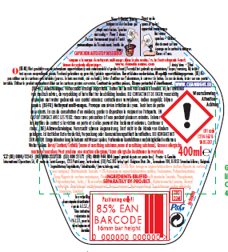
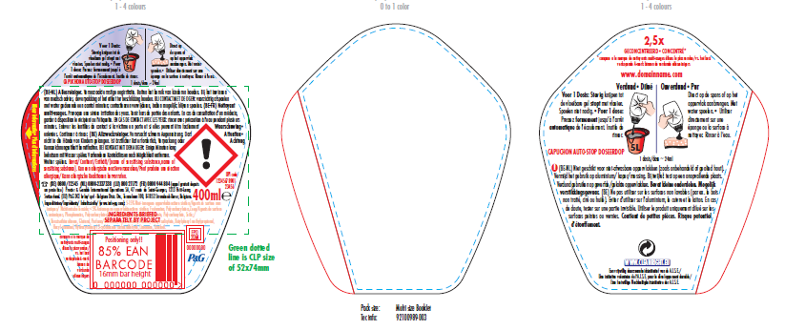
Do consumers notice, understand & act on safety labeling ?
Is all the CLP label text necessary ?
All purpose cleaner not classified under DPD but classified under CLP
(Text does not fit!)
All purpose cleaner classified under CLP
(Resort to investing in booklet label)

Slide 9
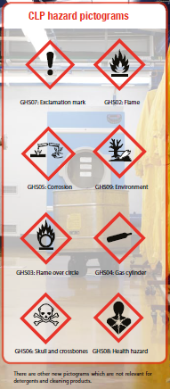
Do consumers notice, understand & act on safety labeling?
CLP >
Do they understand new CLP icons, phrases on detergents ?
New hazard pictograms
New signal words
WARNING indicating less severe hazard
DANGER indicating more severe hazard
New Hazard statements
  e.g. “Harmful to aquatic life with long lasting effects”
New Precautionary statements e.g. “Dispose pack/contents to …..”:

Slide 10

DPD symbols labeled on typical detergent products?
Do consumers notice, understand & act on safety labeling
Human
  skin/ eye irritant or damage; harmful
CLP symbols labeled on typical detergent products?
Human
  skin/ eye irritant; harmful; sensitiser;
skin corrosive/ eye damage
Environment
Harmful to aquatic life with long lasting effects
Phys/Chem. - corrosive to metals

Slide 11
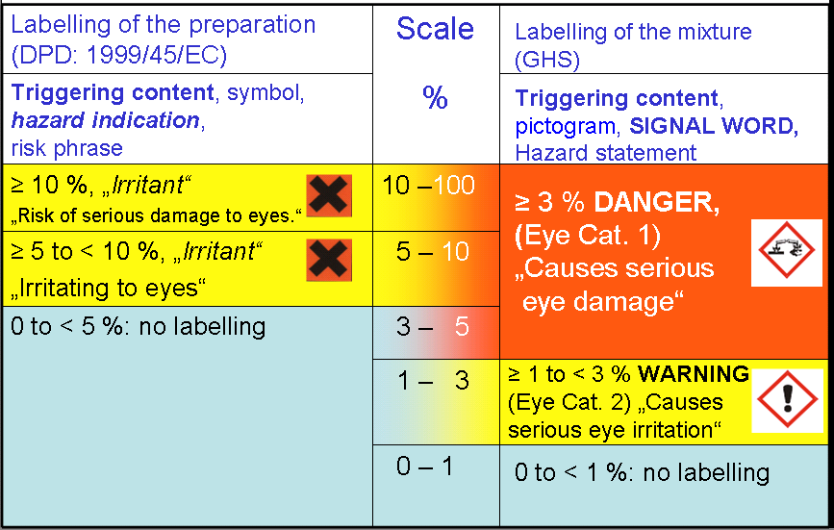
Do consumers notice, understand & act on safety labeling ?
Eye Irritancy under CLP
  More products eye irritant & more irritant products labeled with corrosive symbol
  Consumers don’t understand why their regular detergent came to be labeled with a corrosive symbol !
Notes:
cosmetic vs shampoo

Slide 12
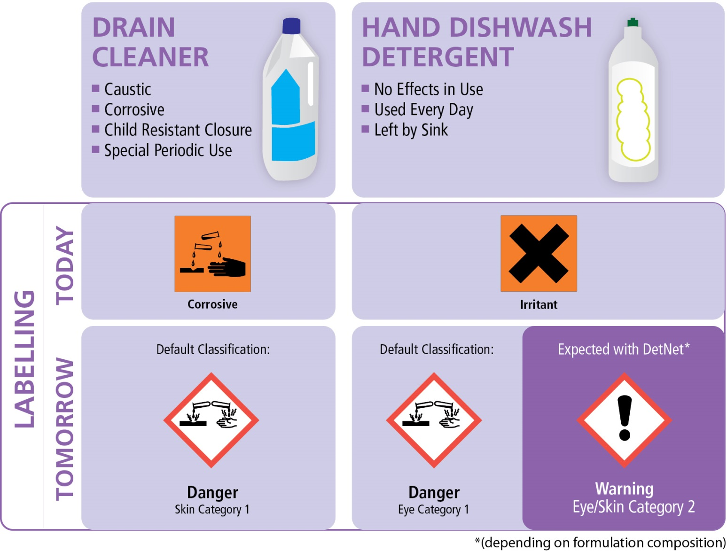
Do consumers notice, understand & act on safety labeling
“Complacency with handling truly dangerous chemicals is a real concern ”
DPD
DPD
CLP
CLP
Danger
Eye Category 2

Slide 13
Do consumers notice, understand & act on – safety labeling?
Detergents required to label a lot of chemistry including % ranges for some ingredients
— phosphates, phosphonates, anionic surfactants, cationic surfactants, amphoteric surfactants, non-ionic surfactants, oxygen-based bleaching agents, chlorine-based bleaching agents, EDTA and salts thereof, NTA (nitrilotriacetic acid) and salts thereof, phenols and halogenated phenols, paradichlorobenzene, aromatic hydrocarbons, aliphatic hydrocarbons,
halogenated hydrocarbons, soap, zeolites, polycarboxylates. enzymes, disinfectants, optical brighteners, perfumes & preservatives
Opportunity to simplify ingredient listing
  label only critical safety ingredients & performance/ claims related ingredients
    list allergens & preservatives only once
    detailed ingredients can be notified to PCCs (CLP Reg.) & public website (Detergent Reg.)
    supplemental digital solutions – Quick Response Codes in store /on pack
Notes:
critiocal information at…..

Slide 14

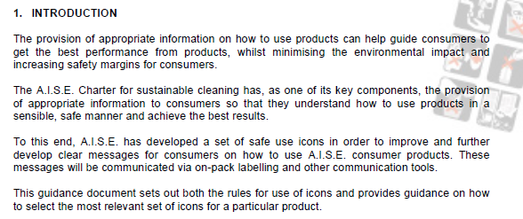
Do consumers notice, understand & act on safety labeling?
AISE Safe Use Icons (since 2004)
Consumer research insights –
  consumers notice pictures and can quickly understand simple visuals
  consumers do not spend the time to read hazard, precautionary text on detergent labels

Slide 15
Is safety labeling fit for purpose?
There are indications that safety labeling could be improved:
  CLP increased label congestion & change management complexity (more classified products, more label information, more individual pack layer labels )
  duplication between legislation & excessive ingredient listing
  Research suggests most consumers:
  do not read detergent label text
    those that do are guided by their risk perception
  notice, understand targeted safety icons
  - Could simplification enhance safe use ?
Notes:
….and we appreciate your help today with guiding that research further and ultimately identifying improvement opportunities.

Slide 16
How can we simplify & improve ?
Get safety labeling/ communication in proportion
  AISE wants safety labeling to be easily visible, understandable, space efficient and innovation friendly.
  We continue to support other medias to drive safe use
Simplify
  Less text and more targeted safe use icons
    Merge Detergent Regulation , BPR Ingredient list & CLP art.18 ingredient lists
    Label only critical safety ingredients & performance, claims related ingredients
    Watch out ! with CLP PCC notifications - Formulation changes not requiring new artwork today should not drive new artwork to accommodate new UFIs
    Notify detailed ingredients to PCCs (CLP ) & public website (Detergent reg.)
      New PCC notification process may render much of on pack safety labeling redundant
    digital solutions -leverage websites and Quick Response Codes in store, on pack
Notes:
mention other solutions…stakeholder campaigns, point of sale info, targeted campaigns
mention ……to possibly evolve aise icons after covering “targeted safe use icons”)

Slide 17
THANK YOU
We look forward to your support this afternoon in
refining our consumer research proposal to better
understand how consumers perceive & use
detergent labels
Lets continue to work together to improve safe use
of detergents by consumers

