Slide 1
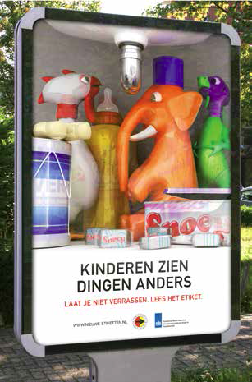
Awareness campaign in the Netherlands on new household chemical labels
Peter Dekker,
Netherlands Food and Consumer Product Safety Authority (NVWA)
AISE workshop
Brussels, 10 June 2016

Slide 2
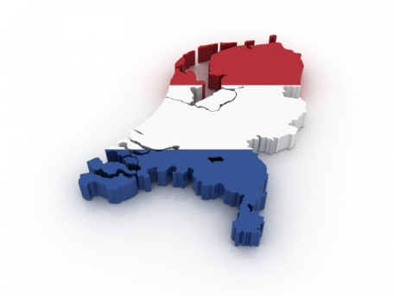
Starting point in 2009
NVWA commissioned a study into consumer attitudes and how consumers use household chemicals. Some results:
    Consumers have a high risk perception of products used on an occasional basis and a low risk perception of products used daily, like most detergents.
    73% state that they read the label on household chemicals, 26% sometimes read the label and 1% never do.
    But if they read the label, do they also follow the information? The study pointed out that a public information programme can improve the comprehension of symbols, but must also show the consumer the importance of reading the safety information and following the safety recommendations!
The Ministry of Health in 2008 commissioned NVWA and VeiligheidNL to develop a long-term campaign to - introduce new labels and - - promote the safe use of household chemicals
Notes:
Why so early start?

Slide 3

Strategy 2009-2015
Increasing consumers' awareness and understanding of the safety information provided by labels on household chemicals and improving safe use:
Focus on awareness and attitude (2010-2011)
Focus on recognising symbols and following safety instructions on the label (2012-2015)
Notes:
The campaign was implemented in two stages. The first of these, which ran
from 2010 to 2011, focused on awareness and attitude. People should be aware
that household chemicals can be dangerous if used carelessly or incorrectly.
The casual “that won’t happen to me” attitude which many people exhibit needed
to be addressed and they needed to abandon their learned behaviour.
Furthermore, Dutch people needed to be persuaded that reading and following
the instructions printed on the label will help them to safely use household
chemicals, since the label provides practical guidelines on what to do. During
the first stage of the campaign, very few household chemicals carried labels.
During the second stage (2012-2015), the new labels and symbols were
introduced, with the focus being on recognising the symbols and actually
following the instructions printed on the label. Starting in 2013, labels began to
be added to a growing number of products, and by 2015 nearly all products had
been reclassified and labelled. The process of introducing the new labels will
be completed in 2017.
Since the safe use of household chemicals is not high on the list of priorities for
many people, it is more important to create appealing campaigns and find
incentives to ensure that people will take action. The particular incentive we
used was child safety. People feel this is important and are willing to change
their behaviour where the health and safety of children is concerned.

Slide 4
Objectives
At least 60% of all Dutch people aged 13 and older had been exposed to one of the campaign communications by the end of 2015. Of the “parents with young children” category, this percentage is 70%.
Of the Dutch consumers and parents who were exposed to the campaigns, a minimum of 60% are familiar with the hazard symbols.
Of the Dutch consumers and parents who were exposed to the campaigns, a minimum of 80% are aware of how to use household chemicals safely.
Of the Dutch consumers and parents who were exposed to the campaigns, a minimum of 50% stated at the end of 2015 that they read and follow safety instructions on packaging.

Slide 5
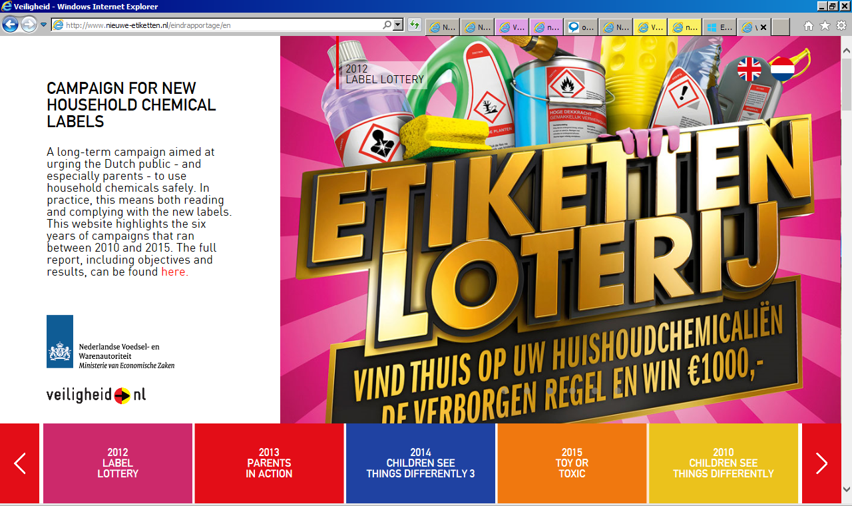
Website
- This website highlights six years of campaigns
- And offers a full evaluation report, including objectives and results

Slide 6
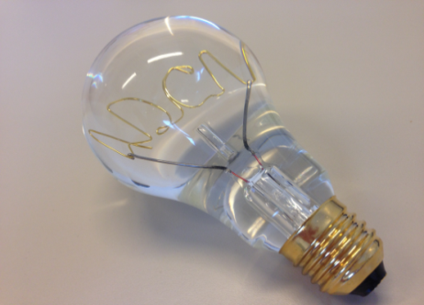
Results of the campaigns 2009-2015
Reach: parents 76% > 70% target
Familiarity with symbols: 66% > 60% target
Awareness important to read the instructions for use and take the necessary precautionary measures: 82%; important to keep household chemicals outside the reach of children: 96%; important to put the top back on the bottle while using a household chemical: 80% > 80% target
Behaviour follow instructions for use and take measures: 76%; keep household chemicals outside the reach of children: 90%; put the top back on the bottle while using a household chemical: 76% > 50% target
The campaign is an effective tool to make people aware of the risks and prepare them for new, safe behaviour
Price winning campaign -> lot of free publicity!

Slide 7
More information
Evaluation of the Dutch awareness campaign for new household chemical labels in the Netherlands 2009-2015:
Website: http://www.nieuwe-etiketten.nl/eindrapportage/EN
Report: http://www.nieuwe-etiketten.nl/eindrapportage/pdf/VEILIGHEID_PDF_ENG.pdf

